Slide 1
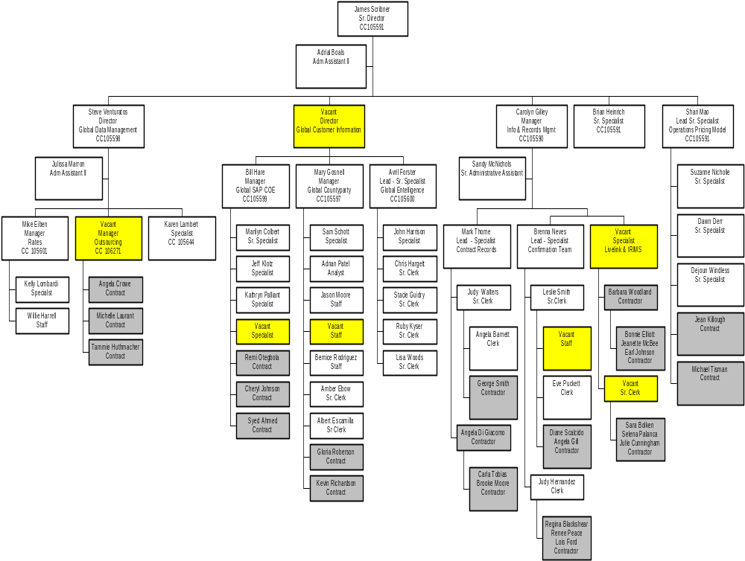
Headcount Filled Vacant
Employees 39 Directors 2 1
Vacants 7 Managers 4 1
Contractors 26 Sr. Spec 7
Total 72 Spec 8 2
Staff 4 2
Analyst 1
Sr. Clerk 7 1
Clerk 3
Adm 3
Contractors 26
Total 65 7

